Slide 1
CARPAL TUNNEL SYNDROME
Dr.Nisha
Assistant professor
Dept:of practice of medicine

Slide 3
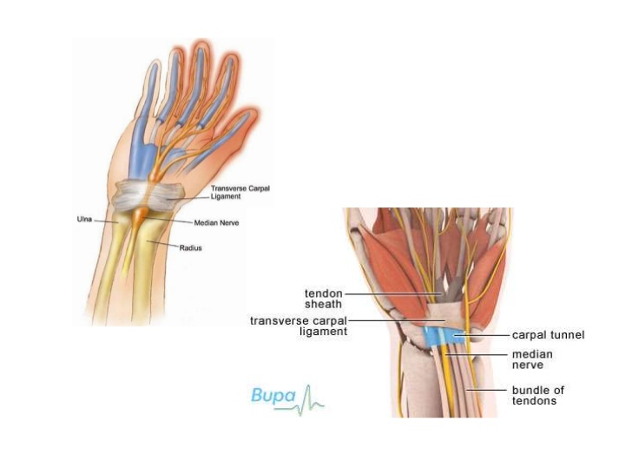

Slide 21
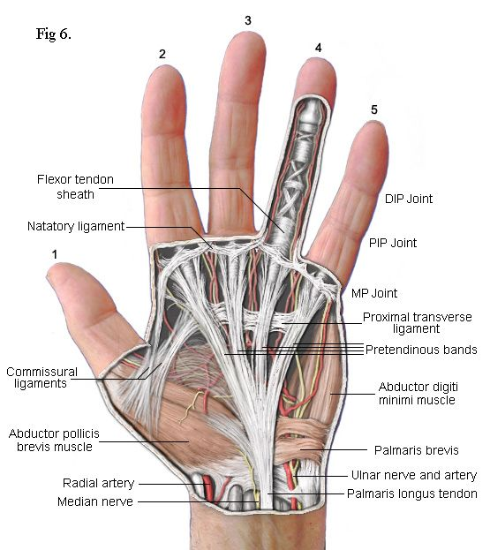

Slide 22
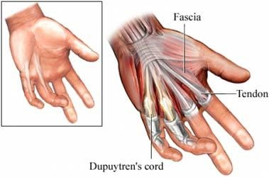

Slide 24
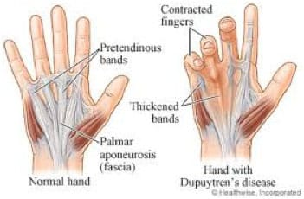

Slide 32
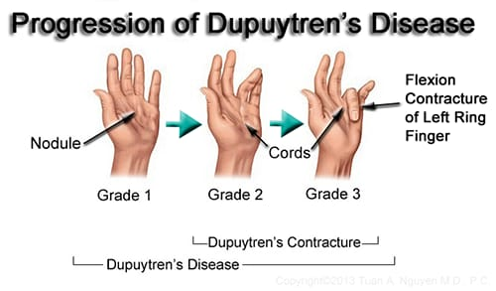

Slide 33
